Slide 1
REAL ESTATE
PRICES PREDICTION

Slide 2
TABLE OF CONTENTS
01
02
03
Introdiction
Data
Relations
04
05
06
Results
Conclusion
Demo

Slide 3
Introduction
Problem
In these days, the real estates in Riyadh is a hot topic and the prices changes monthly because of the high demand. Most of the preparty owners those trying to set a selling price for their property does not know what is the best price which make them set a high price or to low.
Our solution
In this project, we will develop a linear regression model to predict the property prices according to its characteristics and location. Which will help the owners to set the best price.

Slide 4
OUR Data
Data Source
Data columns
We have used Web Scrapping to collect our data and the source was Aqar site and Wekipedia
BEDROOM
BATHROOM
SIZE
DISTRICT
PRICE

Slide 5
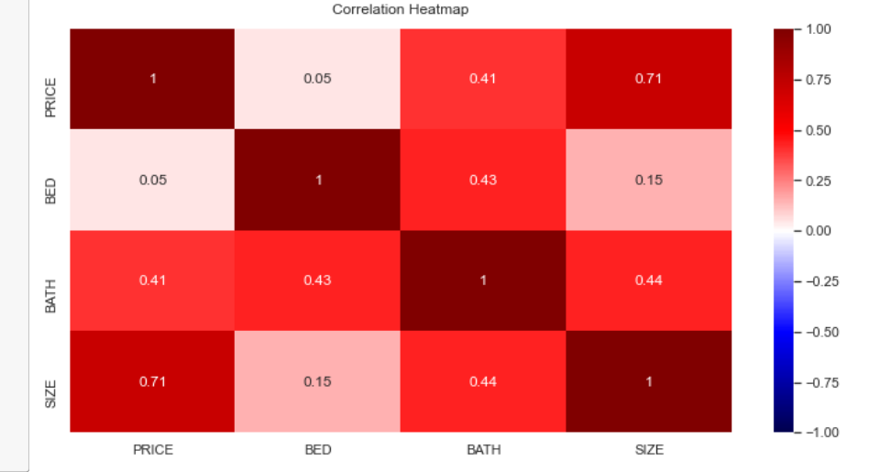
Relations

Slide 6
Results
 | Linear Regression | Ridge Regression
X | R² = 0.793 CV = 0.767 | R² = 0.820 CV = 0.757
BED and BATH squared | R2 = 0.793 CV = 0.767 | R² = 0.820 CV = 0.755
SIZE/BED | R² = 0.792 CV = 0.759 | R² = 0.829 CV = 0.751
Drop Distrect | R² = 0.692 CV = 0.512 | R² = 0.715 CV = 0.512
SIZE squared | R² = 0.833 CV = 0.810 | R² = 0.842 CV = 0.817

Slide 7
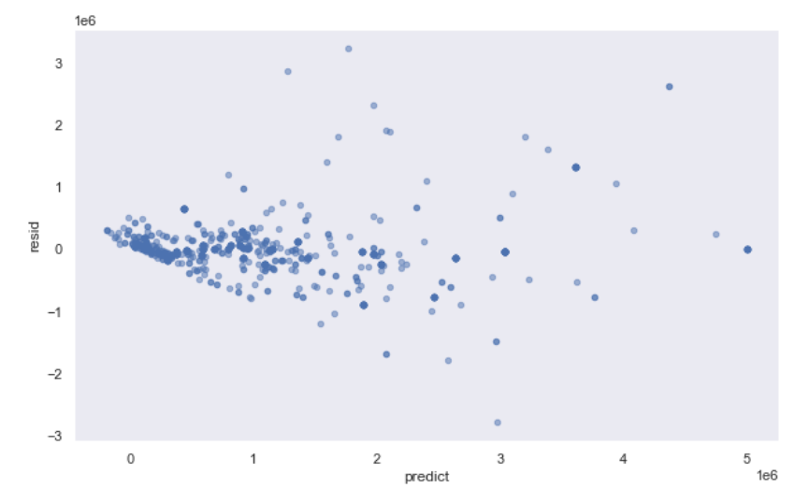
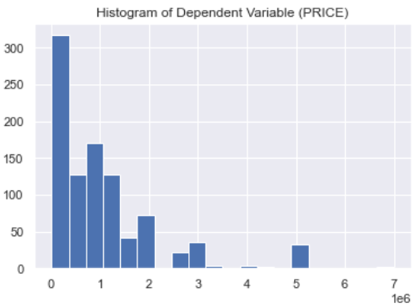
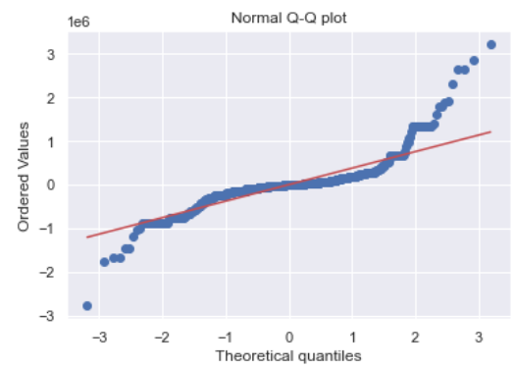
Assumption1: normally distributed with zero mean

Slide 8
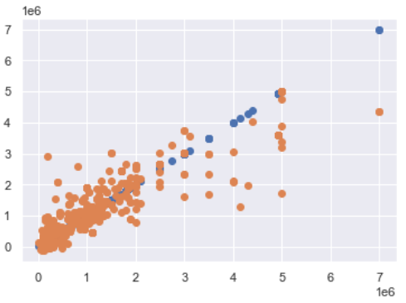
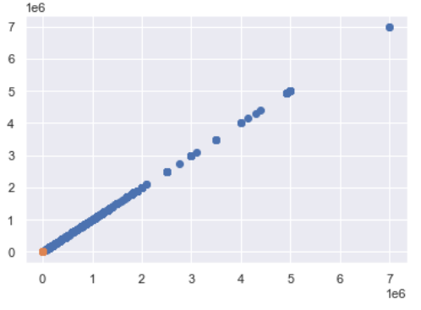
Assumption2: error terms must have constant variance
Actual
After using log

Slide 9
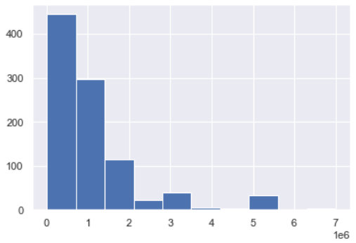
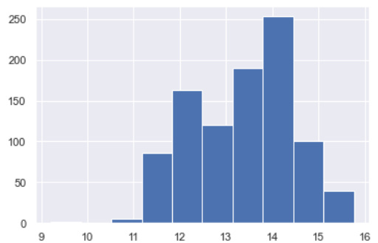
Assumption2: error terms must have constant variance
Actual
After using log

Slide 10
Conclusion
we have accomplished a good results model and from using updated and real data. we develop two models linear and ridge. all of those model has a very good results as a start

Slide 11
THANKS
Does anyone have any questions?

